Slide 1
Personal finance

Slide 2
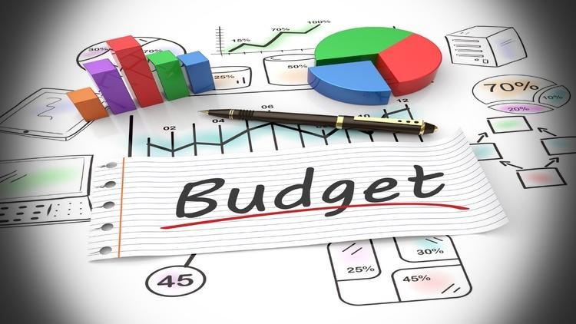
Personal budgeting and savings
personal budgeting
Personal budgeting means planning how to use your money so that income and expenses are balanced.
Personal savings
Savings is the money kept aside after expenses for future use like emergencies, education, travel, or investments.

Slide 3

2. Retirement planning
Retirement planning
Preparing financially for life after you stop working, so you can live comfortably without depending on others.
Sources of Retirement Income
Pension
Provident Fund (PF / EPF)
National Pension System (NPS)
Savings and investments
Fixed deposits, mutual funds

Slide 4

3. Tax planning
Tax planning
Legally reducing tax liability by properly using exemptions, deductions, and rebates allowed under tax laws.
Objectives of Tax Planning
Reduce tax payable
Increase savings
Proper financial planning
Avoid last-minute tax burden

Slide 5

4. Insurance and risk protection
Insurance
Financial protection plan where a person pays a small amount (premium) regularly to protect against financial loss due to risk.
Risk protection
Reducing financial loss caused by unexpected events using tools like insurance.

Slide 6

5. Debt management
Debt
Money borrowed from banks or lenders that must be repaid with interest.
Examples: home loan, education loan, credit card dues.
Debt management
Planning and controlling borrowed money so that loans are repaid on time without financial stress
Importance of Debt Management
Avoids over-borrowing
Reduces interest burden
Maintains good credit score

Slide 7
Thank you

